Slide 1
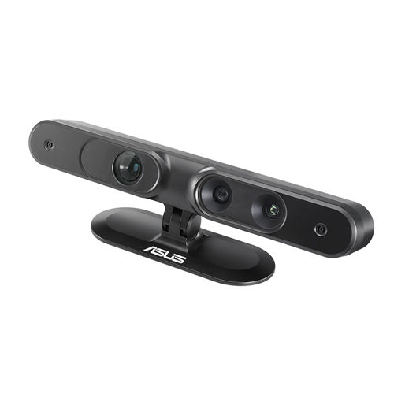
Estimated
Depth
Keyframe
t₁
Estimated sim(3)
transformation
Estimated sim(3)
transformation
t₃
t₂
Tracked
Frame
Tracked
Frame
Estimated sim(3)
transformation

